Slide 1
8th Annual Spatial Ontology Community (SOCoP) of Practice Workshop:
Developing Geo/Earth Science Related Ontology Patterns
Nov. 30 -Dec. 2, 2015
USGS National Facility
Reston, VA
Thank you USGS and its Center of Excellence for Geospatial Information Science
Workshop info: http://vocamp.org/wiki/GeoVoCampDC2015
Tweet: #geovocampdc15
Life Cycle
Assessment
Start on a microtheory?
Setting
Theme
Spatial
Time
GeoSPARQL
Geometry
Material
Transformation
Surface
Networks
Contour
Boundary
Event
Surface
Water
Cartographic Symbology
Motion
Transport/Cruises
Path
GeoVoID
Point of Interest
Semantic
Trajectory
Containment
Start on a microtheory?
Refined for application?
CityML
University
Building

Slide 2
Logistics
Call in a touchtone, landline phone, US/Canada participants dial:
Verizon Toll Free:
username: vocamp1
Password: Usgs12345$
The conference call-in number (1-866-687-7995)
E. Lynn Usery has ​provided this info to join ​the VocCampDC​ meeting on the Web, using WebEx USGS
Main WebEx Sessions Day 1 afternoon, and Days 2-3 morning sessions as well as possible end of day summaries in the main meeting room.

Slide 3
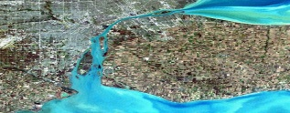
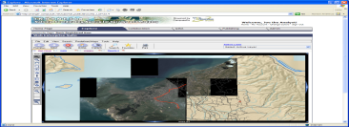
8th Annual SOCoP Workshop
SOCoP collaboration was officially begun in October of 2006
Purpose: to continue the discussion as follow-up previous VoCamps participated in by SOCoP+ members.
The session is organized around 3-4 Work Groups made up of domain experts, group facilitators and people with semantic/ ontological experience.
This will be a great opportunity for people interested in using semantics to see lightweight approaches applied in context.
4

Slide 4
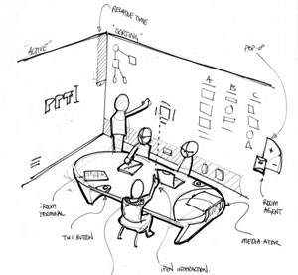
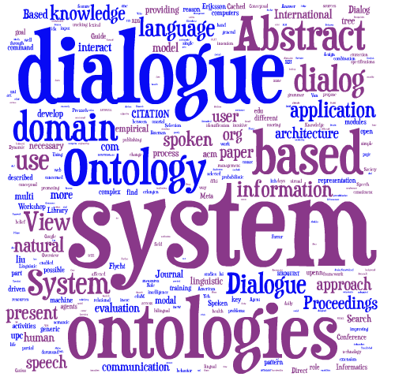
Workgroups/Breakouts Include Multiple Roles:
“Group Work on Semantic Models of Interest”
Semantic Engineering is a Socio-Tech Process
Domain/Data Expert
Ontologist
Note taker
Tools...
Facilitator

Slide 5
Logic of Work Sessions
At end of day
Group Reports on status
At end of day Report back
to whole and wrap up
After break Group Work
on Draft Models
After lunch Prepare Report
2nd Day Group Work on
Concepts, Vocabulary & Model(s)
firm up products
and test against data
Start Group organization &
Introductions, goals and process
Draft final model
& initial formalizations
After break Work Groups
polish, formalize models
Start Here Day One Intro,
Topics, Methods..
3rd day
Remote advice

Slide 6
Agenda Monday Afternoon, Nov. 30th, 2015
12:30-1:00 Welcome, Introductions, Logistics and Schedule Overview Room 1B215
Note – This session includes WebEx as a virtual meeting
1:00- 1:25 Workshop Descartes Core Vision, Strategy & Methods- Gary Berg-Cross
1:25 – 1:45 Overview of the new VoCamp GitHub repository for Products, Briefings etc. Charles Vardeman.
1:45 - 2:45 Working Topics (Presented by Topic Leaders)
Physical Samples (Richard)
3 D spatial Patterns (Vardeman)
Topographic Eminences and Terrain Convexities (Sinha)
2:45- 3:00 Break
3:00-4:45 Group organization and introductions - setting goals and process
in 3 “Breakout Rooms”
Remote participation & presentations as decided by Topic Leaders
4:45-5:30 Group Reports to the Whole – Main room as a virtual meeting
Post 5:30 PM – Groups may make arrangements for dinner on their own. Our tradition has been to go to Clyde’s in Reston at least one of the nights.

Slide 7
Tuesday Dec. 1
9:00~9:15 Updates, Q & A etc. (schedule etc.) Main room
9:15-10:45 Group Work on Concepts, Vocabulary and Model (Breakout Rooms)
11:00-12:15 Group Work on Draft Models (Breakout Rooms)
12:15 -1:15 Lunch and Networking – USGS cafeteria
1:15- 2:45 Work Groups – draft final conceptual model (Breakout Rooms)
2:45- 3:15 Work Groups identify data to test model & initial formalizations Prepare
3:15-3:30 Break
3:30-4:30 Prepare Brief Back Report (Breakout Rooms)
4:30-5:00 Interim Group reports Main Room (Broadcast as Virtual Meeting)
5:00 -5:30 Tentative Krzysztof Janowicz Descartes Core & ODP briefing and (Broadcast as Virtual Meeting)
Anyone want to organize a group dinner???.

Slide 8
Wed. Dec. 2
9:00-9:15 Updates, Q & A etc. (schedule, GiTHub effort etc.) Main Meeting Room
9:15- 9:45 Presentation by Pascal Hitzler, on some formalization thoughts based
on group work
9:45-10:45 Work Groups Firming up products and alignments (Breakout Rooms)
10:45-11:00 Break (USGS cafeteria etc. )
11:00-12:00 Prepare group reports and plans for follow up(Breakout Rooms)
12:00 -1:00 Lunch and Networking - On your Own
1:00 ~ 2:30 Group reports & Wrap up (Main Room)

Slide 9
History of our VoCamps
NeoGeoVoCampOctober2009
GeoVoCampDC2011
GeoVoCamp Santa Barbara 2012
GeoVoCamp Dayton 2012
GeoVoCamp SOCoP DC 2012
1st Vocamp - Energy Efficiency in Buildings.
Descartes-Core GeoVoCamp Santa Barbara 2013
SOCoP's GeoVoCampDC2013 held at NSF Nov. 18-19, 2013
Descartes-Core GeoVoCamp Santa Barbara 2014
GeoVoCamp at USGS in DC - GeoVoCampSOCoP2014
GeoVoCamp Santa Barbara 2015 (March 23-25, 2015)
VoCamp Notre Dame 2015 (May 18-19, 2015)

Slide 10
Some VoCamp Products
A geo-ontology design pattern for semantic trajectories
Hu, Y., Janowicz, K., Carral, D., Scheider, S., Kuhn, W., Berg-Cross, G., Hitzler, P., Dean, M., Kolas, D.
Lecture Notes in Computer Science (including subseries Lecture Notes in Artificial Intelligence and Lecture Notes in Bioinformatics) volume 8116, issue , year 2013, pp. 438 – 456
Hitzler, Pascal, Krzysztof Janowicz, and Adila A. Krisnadhi. "Ontology modeling with domain experts: The GeoVoCamp experience." Proceedings of the Diversity++ Workshop Co-Located with the 14th ISWC 2015. 2015.
Followed up with more work as GeoLink
Krisnadhi, A. A., et al. "The GeoLink framework for pattern-based linked data integration." ISWC2015 Poster Proceedings (2015).
Krisnadhi, Adila, Yingjie Hu, Krzysztof Janowicz, Pascal Hitzler, Robert Arko, Suzanne Carbotte, Cynthia Chandler et al. "The GeoLink Modular Oceanography Ontology."
Krisnadhi, A.A., Hu, Y., Janowicz, K., Hitzler, P., Arko, R., Carbotte, S., Chandler, C., Cheatham, M., Fils, D., Finin, T., Ji, P., Jones, M., Karima, N., Mickle, A., Narock, T., O’Brien, M., Raymond, L., Shepherd, A., Schildhauer, M., Wiebe, P.: The GeoLink framework for pattern-based linked data integration. In: ISWC2015 Poster Proceedings (2015),
Janowicz, K., Krisnadhi, A.A., Hu, Y., Suh, S., Weidema, B.P., Rivela, B., Tivander, J., Meyer, D.E., Berg-Cross, G., Hitzler, P., Ingwersen, W., Kuczenski, B., Vardeman, C., Ju, Y., Cheatham, M.: A minimal ontology pattern for life cycle assessment data. In: Proceedings of the Workshop on Ontology and Semantic Web Patterns (6th edition), WOP2015, Bethlehem, PA, October 2015 (2015),
Vardeman II, Charles F., Adila A. Krisnadhi, Michelle Cheatham, Krzysztof Janowicz, Holly Ferguson, Pascal Hitzler, and Aimee PC Buccellato. "An Ontology Design Pattern and Its Use Case for Modeling Material Transformation.“
Hitzler, Pascal. "Ontology Design Patterns as the next step in Web Semantics.“
Gary Berg-Cross, "The GeoVoCamp Workshop Experience and Ontology Design Pattern Development." in Narock, T., and P. Fox. The Semantic Web in Earth and Space Science. Current Status and Future Directions 20 (2015): 171.

Slide 11
Overview of Lightweight Methods: Low hanging fruit leverages initial vocabularies (e.g. Feature, Site) and existing conceptual models to ensure that a semantics-driven infrastructure is available for use in early stages of work and used to clarified agreement & reduce ambiguities/conflicts on geospatial & related phenomena
Ontology Engineering
Problems, Component and Relation Identification & Clarification
  Conceptualization Phase
Agreements can then be formally represented in:
  Constrained, engineered models
  Systematic organization & framing with visual expression
  “Patterns are viewed as strategies which ease the creation of application ontologies by non-experts”.
We like data-grounded work with interoperability in mind
Lightweight Methods:
develop general, reusuable patterns that provide a common, modular framework to generate ontologies that are consistent and can support interoperability.
Formalization
Notes:
Our approach is to Much of the utility of geospatial ontologies will likely come from their ability to relate geospatial data to other kinds of information.

